Slide 1
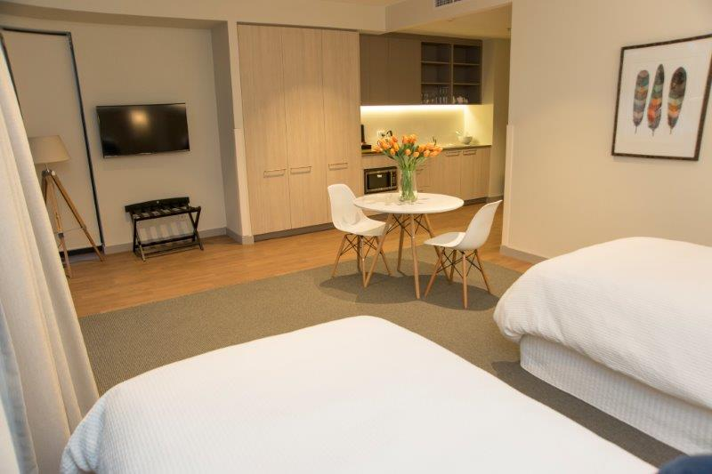
Guest accommodation @ Carrington
‘more than you expect and all that you need’
To support the well-being of our residents, Carrington warmly invites family members and friends to spend time with us in our comfortable guest apartments. For your convenience, these apartments are located on-site and give you quality accommodation at a reasonable price.
Information Pack
Contact:
Customer Services on  (02) 4659 0590
90 Werombi Road
Grasmere NSW 2570
www.carringtoncare.com.au

Slide 2
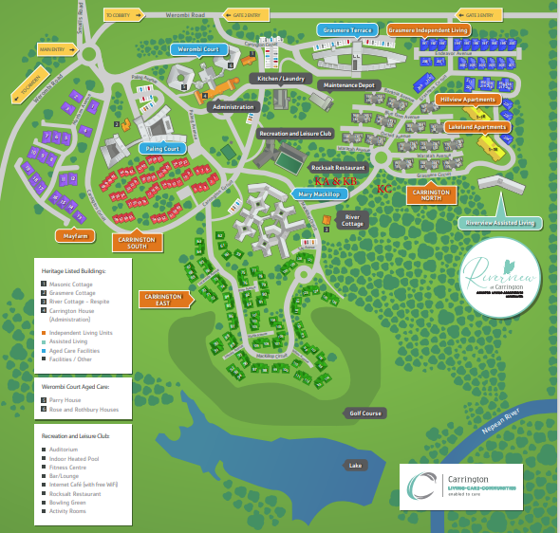
Guest accommodation @ Carrington
‘more than you expect and all that you need’
Our Location
Our guest accommodation is located on-site at Carrington in our Paling Court facility. Our street address is 90 Werombi Road, Grasmere NSW 2570.
We are conveniently located five minutes from the historic township of Camden.
Parking
Parking is available (as indicated by red arrow) on-site in the Paling Court facility underground carpark. Parking is conveniently located in close proximity to the apartment entry on level 1 of the car park and is signposted. At check in, an electronic fob will be provided with the apartment key. This fob will provide access to and from the carpark.

Slide 3
Guest accommodation @ Carrington
‘more than you expect and all that you need’
Our Apartments
Our guest accommodation comprises of two separate apartments. Each apartment contains two single beds, including pillows, high quality linen and towels. A cot and a roll-away bed are also available on request at an additional cost.
For larger family bookings, please speak with staff if you require both rooms for your family stay.
Check-in and Check-out times
Carrington offers flexibility in check in times when necessary. Please discuss your requirements with our receptionist who will assist wherever possible.
Check out time is 10.00 am. Check in time is from 2.00 pm.
Our facility can accommodate guests who require wheelchair or walking frame access.

Slide 4
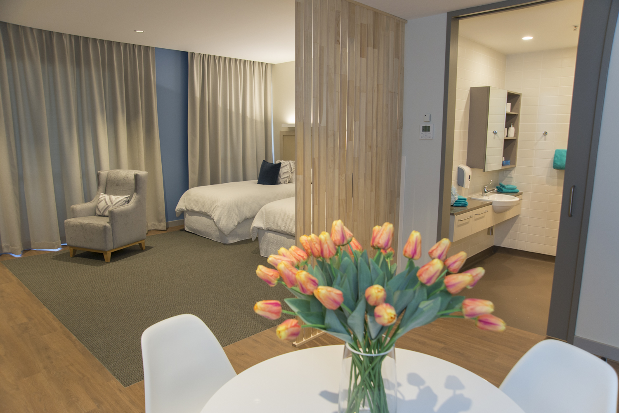
Guest accommodation @ Carrington
‘more than you expect and all that you need’
Amenities
Your apartment contains the following:
Ensuite bathroom, hairdryer, easy access shower and bath linen
Kitchenette including cutlery, crockery, microwave, sandwich maker, salad bowl, cutting board, cutting knife, dishwashing liquid, tea towel
Tea and coffee making facilities
Fridge (small)
Air conditioning
Television
Phone
Iron and ironing board
In-room dining table and chairs
The room does not contain an oven, stove, toaster, washing machine or dryer.
There are no pets allowed in the apartments.
Both apartments are non-smoking. If there is evidence of smoking in the room, an additional cleaning fee of $99.00 may be charged.

Slide 5
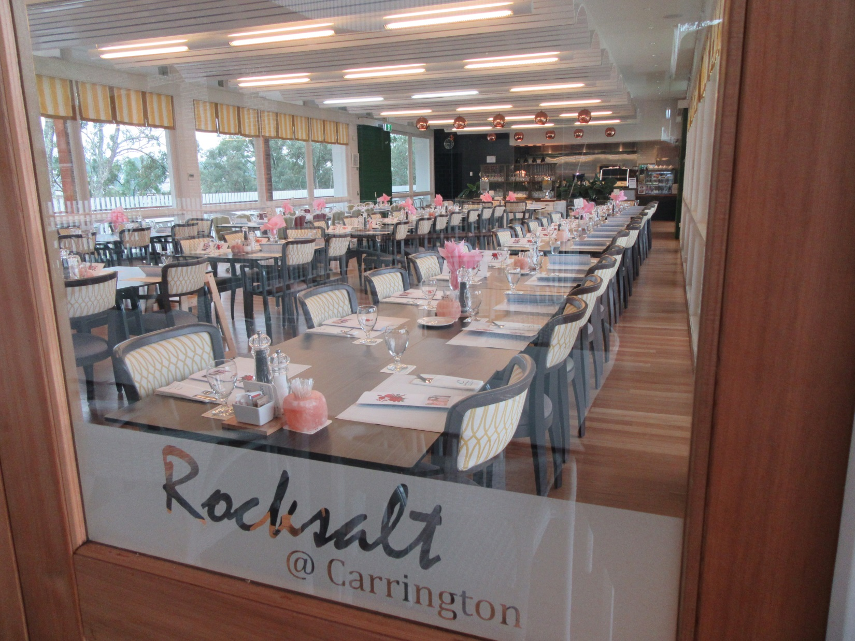
Guest accommodation @ Carrington
‘more than you expect and all that you need’
Meals and Dining
Your room charge includes a continental breakfast with a selection of boxed cereals, milk, bread, condiments, tea and coffee. A selection of pre-packaged sandwiches and cakes and coffee making service are available in the Paling Court Kiosk located on the ground floor (refer to trading hours located in a brochure in your room).
Carrington’s Rocksalt Restaurant is located in our Recreation and Leisure Club. The restaurant is open Wednesday - Sunday from 9.30 am - 3.00 pm. The restaurant offers a range of freshly cooked meals, cakes, coffee etc. A full menu, with trading hours and home delivery service is located in your room for your convenience.
Arrangement for dining in the residential dining rooms in the facilities can be made at the time of booking. A fee of $13.00 per meal is applicable.

Slide 6
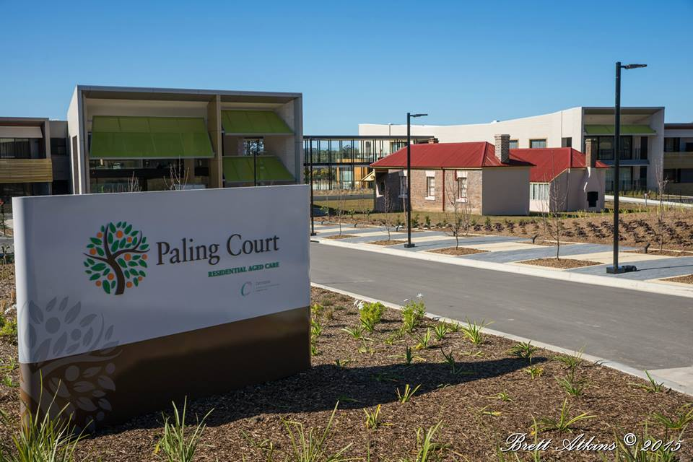
Guest accommodation @ Carrington
‘more than you expect and all that you need’
Phone and Contacts
A phone is available in each apartment. Local calls only can be made from the phone. Please dial zero to obtain an outside line before dialling the required number.
For incoming calls, the phone numbers are as below:
Apartment 1: (02) 4659 0482
Apartment 2: (02) 4659 0470
Your primary contacts at Carrington are:
Customer Services  (02) 4659 0590
Paling Court Team  (02) 4659 0530

Slide 7
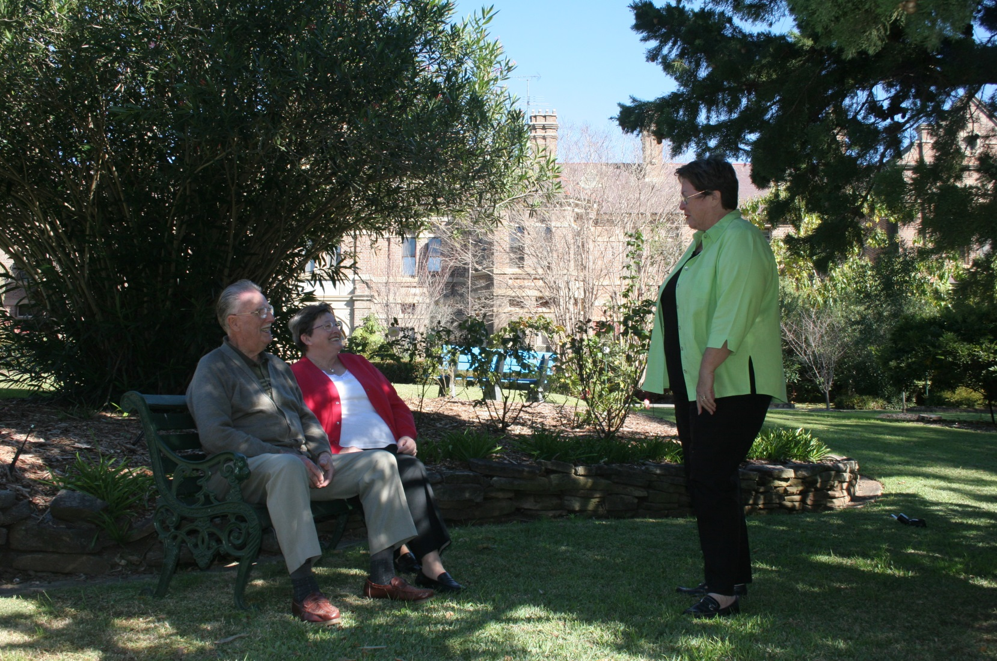
Guest accommodation @ Carrington
‘more than you expect and all that you need’
Payment Options
We offer you a range of payment options:
EFT
Credit Card
Direct Deposit
Cash payment in person
Contact:
Customer Services  (02) 4659 0590
to arrange payment
Fees
Our apartment fee is $99.00 per night, per room including continental breakfast.
Our family rate is $149.00 per night, for both apartments including continental breakfast.
Carrington offers our apartments to families of residents who are diagnosed at end of life stage on a cost recovery basis only. Please discuss your individual requirements with our Customer Services Officer on (02) 4659 0590. A $50.00 fee per room/per night will be charged.

Slide 8
Guest accommodation @ Carrington
‘more than you expect and all that you need’
Additional Information
Our site is monitored by external security services.
Our rooms are fitted with fire sprinklers and fire doors are installed for your safety. Egress into the car parking area is in the immediate vicinity of your apartment.
For your engagement and at your expense, these services are available to you if required.
Local taxi services are available by contacting: Camden Taxis, 31 Blaxland Road, Campbelltown  (02) 4625 2922
Laundromat services are available by contacting: Camden Laundry, Shop 18 Camden Village Court, Argyle Street, Camden  (02) 4655 2008
Enjoy your stay

